Slide 1

Machine Learning with Java - JSR 381 Visual Recognition
Ken Fogel
Java Champion
JCP EC Member
Research Scholar in Residence – Dawson College
Packt & Apress Author
Retired Dawson College CS Instructor

Slide 2
Available Now!
The beginner's book for experienced programmers.
Are you proficient with Python, C#, C, C++, or others?
Need to learn Java?

Slide 3
First, some credit for the source material in this presentation
This presentation is based on the work of the following two developers/researchers, with their permission, that are part of the team who developed JSR 381

Slide 4
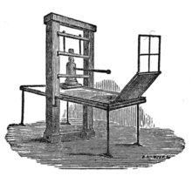
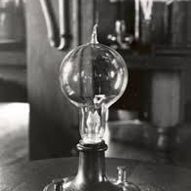
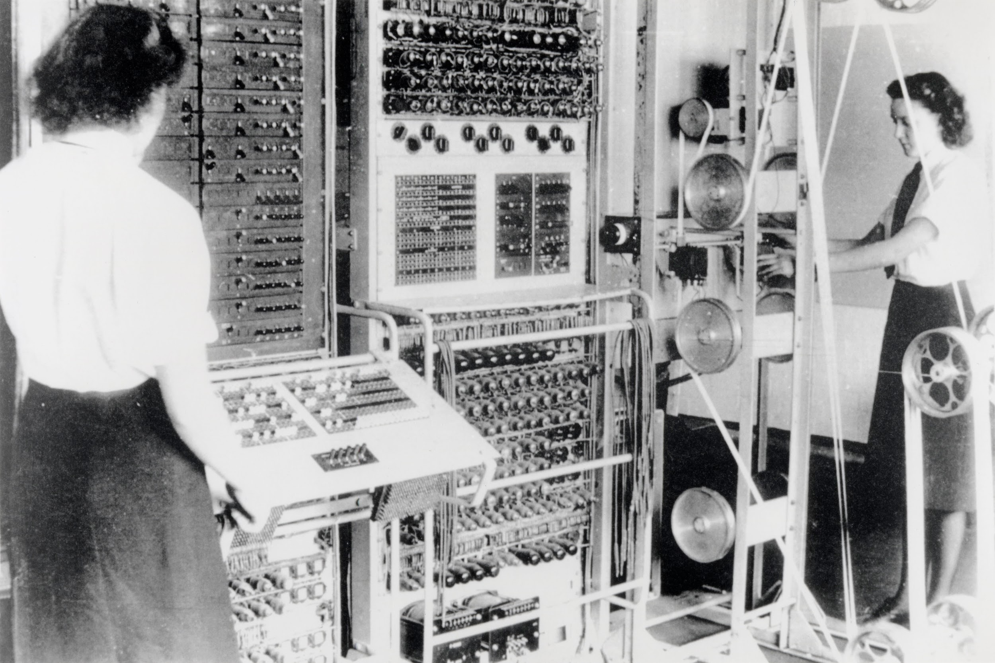
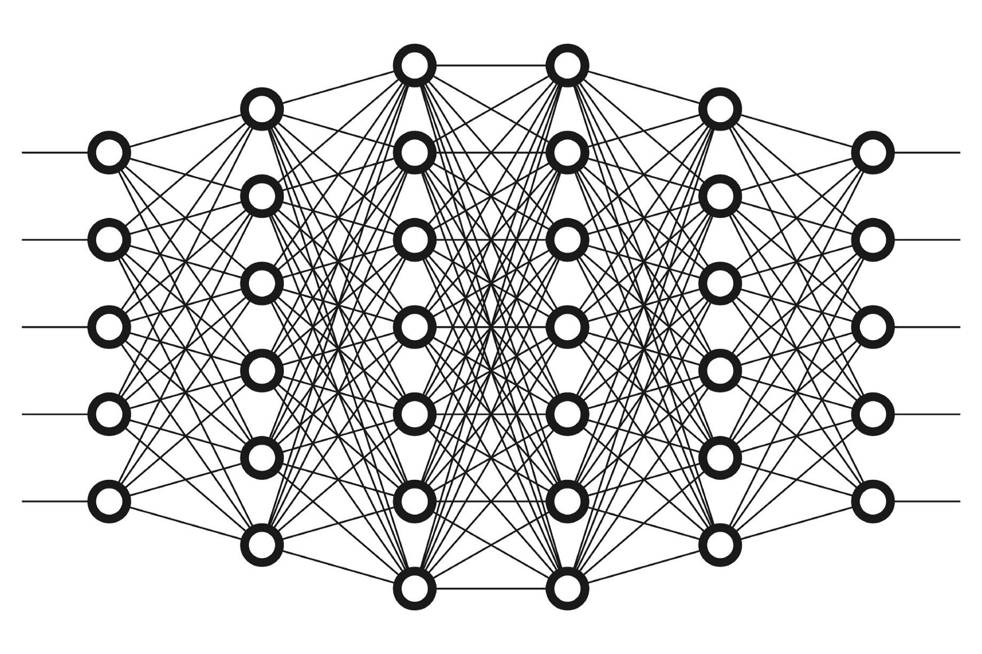
Machine Learning Huge Impact on Everything...
Notes:
ML is a major innovation with many implications for humanity.

Slide 5

Patterns...

Slide 6
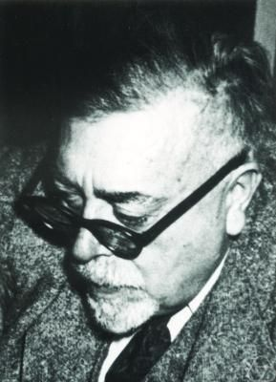
“One of the most interesting aspects of the world is that it can be considered to be made up of patterns”
Norbert Wiener - 1894-1964 - MIT
Cybernetics (1948) - early steps to modern AI
This was AI before it was called “AI”

Slide 7

The Core of Machine Learning
Recognizing PATTERNS in data and Making PREDICTIONS against that data.
Notes:
Then: ALGORITHMS + data = solution
Now: algorithms + DATA = solution
Lehman - monitoring Fixed Income subsystems for KPIs. Managers were not overly interested in up/down, cpu load, memory usage, http requests, etc… they wanted to know any issues were not addressed (notifications to humans were essentially useless), if they made money and most importantly why did they make money.

Slide 8

You can write your Machine Learning app in any language you want, as long as it’s Python.
Notes:
:))))

Slide 9

You can write your Machine Learning app in any language you want, as long as it’s Python.
Hey!!
Notes:
:))))

Slide 10

HEY!
HEY!
HEY!
HEY!
HEY!
HEY!
HEY!
HEY!
HEY!
HEY!
HEY!
HEY!
HEY!
HEY!
HEY!
HEY!
HEY!
HEY!
HEY!
HEY!
HEY!
HEY!
HEY!
HEY!
HEY!
HEY!
HEY!
HEY!
HEY!
HEY!
HEY!
HEY!
HEY!
HEY!
HEY!
HEY!
HEY!
HEY!
HEY!
HEY!
HEY!
HEY!
HEY!
HEY!
HEY!
What the Hey!
~12M Java Devs
Notes:
:))))

Slide 11
Java Needs to be a First Class Citizen for ML
Don’t want another JavaScript Doomsday Scenario occurring in our Lifetime
Python is a good language. There should be others to express the world’s creativity.
Java is a great language with a huge ecosystem with 12M developers
Existing ML APIs aren’t Java-friendly or AppDev-friendly
Notes:
JavaScript as the only language for the Web restricts creativity and innovation. There should be many languages to express ideas.

Slide 12
JSR 381 - Visual Recognition API
Java-friendly standard API for computer vision tasks using ML
Provides a generic ML API
Designed for Java app devs
Multiple implementations
High level abstractions
Readable and easy to use

Slide 13
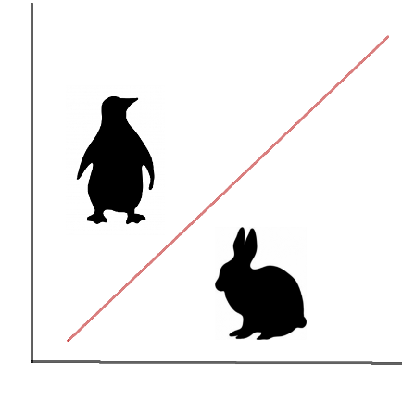

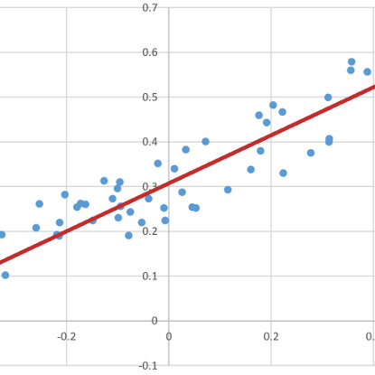
What Can you Do with It?
Object Detection
classification + regression(position)
Classify images and data/objects
Classification task / differentiate between categories
Estimate value
regression task
Notes:
Assign items to predefined categories (Classification task, incl. Image classification=classification with image data as input)
Model relationship between some values in order to be able to predict them
Regression task
In order to understand the context of the design....
Show to developer who dont knows about ML, how to think about the machine learning and use it
ML is a type of algorithm which can automatically tune its internal parameters in order to be able to perform some task with degree of accuracy.
It performs this self configuration using a given set of examples (data set)

Slide 14
Apps/Libs
VisRec Public API
Visual Recognition
Image Abstraction
JSR381
Visual Recognition Layer
Generic ML Layer
Service Provider Interface
JSR 381 Architecture
Service Provider Impl
Service Provider Impl
ML Engine 1
ML Engine 2

Slide 15
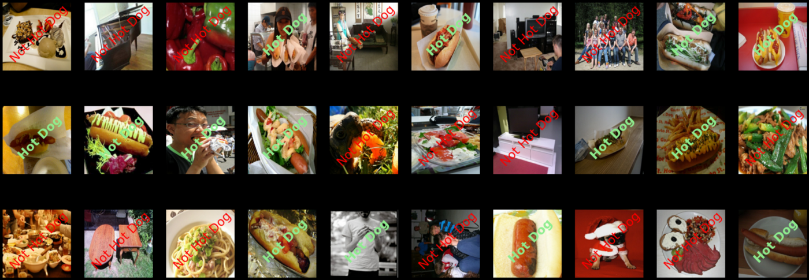
Hot Dog or Not Hot Dog
Hot Dog or Not Hot Dog
Scene from TV show Silicon Valley https://www.youtube.com/watch?v=vIci3C4JkL0

Slide 16

Demo Time!

Slide 17
The future of AI/ML in Java
Upcoming enhancements to the language will be significant for ML
JEP 417: Vector API - https://openjdk.org/jeps/438
Project Valhalla – Value Objects
Project Panama – Connecting Java to foreign (non-Java) libraries such as those written in C.
This will allow Java to use an AI/ML written in C/C++

Slide 18

Reference Implementation
Reference implementation of VisRec API is based on the Deep Netts Community Edition which is a Java based deep learning library provided by www.deepnetts.com
More info: https://www.deepnetts.com/blog/deep-netts-community-edition
DeepNetts has released a community edition of their deep learning engine, and contributed their experience to this JSR as a part of their open-source strategy

Slide 19

Additional Implementation
There is a second ML library that is compatible with JSR 381
The AWS Deep Java Library or DJL
Open-Source library from Amazon
To learn more visit https://github.com/deepjavalibrary/djl
JSR 381 DJL implementation https://github.com/JavaVisRec/visrec-djl

Slide 20
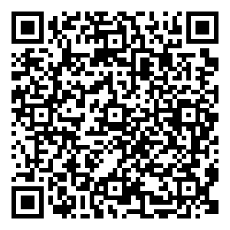
How to get started
github.com/JavaVisRec/visrec-api/wiki/Getting-Started-Guide

Slide 21
JSR381 Information
JCP.org https://jcp.org/en/jsr/detail?id=381
JSR project on GitHub github.com/JavaVisRec
API github.com/JavaVisRec/visrec-api
RI github.com/JavaVisRec/visrec-ri
Examples github.com/JavaVisRec/jsr381-examples
Mailing list visrec@groups.io
Notes:
Mention nd-standardization

Slide 22
Here is a list of image datasets:
http://vision.stanford.edu/aditya86/ImageNetDogs/
https://stanfordaimi.azurewebsites.net/
https://imerit.net/blog/22-free-image-datasets-for-computer-vision-all-pbm/
https://datagen.tech/guides/image-datasets/image-datasets/
https://hackernoon.com/top-20-image-datasets-for-machine-learning-and-computer-vision-rq3w3zxo
https://storage.googleapis.com/openimages/web/index.html
https://www.analyticsvidhya.com/blog/2018/03/comprehensive-collection-deep-learning-datasets/

Slide 23


Questions or Comments?
You can find me at:
Twitter - @omniprof
Mastodon - @omniprof@mastodon.social
Or reach out to
Zoran @zsevarac or Frank @frankgreco

